Slide 1
CAR Administrator Calibration Meeting - CAR Review -
February 26 2013
Team A: Paul Ip, Thomas Kestner, Balina Ling, Kila Yang

Slide 2
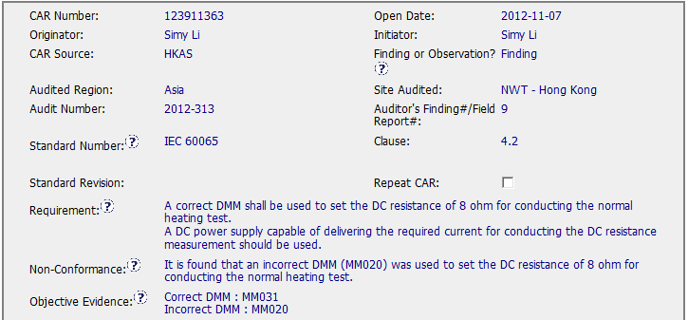
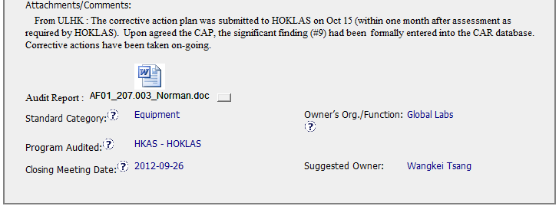
Exemplary Finding CAR No. 123911363

Slide 3
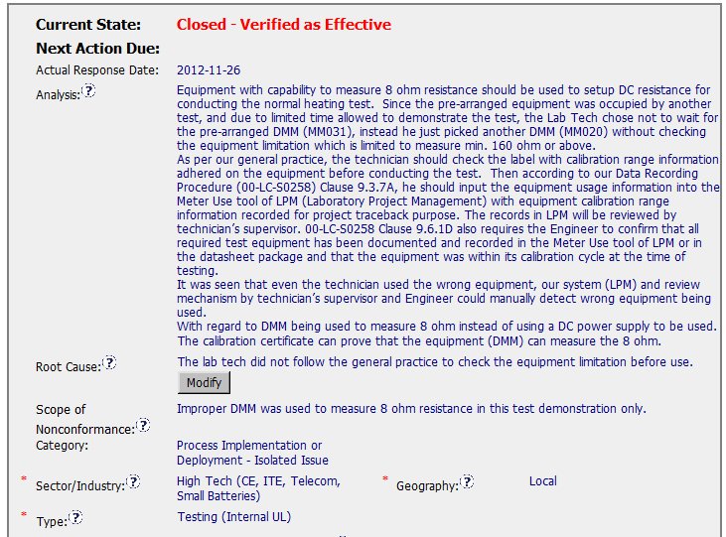
Exemplary Finding CAR No. 123911363
1. Clear analysis and describe with facts. And the root cause is reasonable and complete based on the analysis.
1
2
2. Scope tells us how widespread the problem is, for this CAR, it is just limited to this demonstration test.

Slide 4
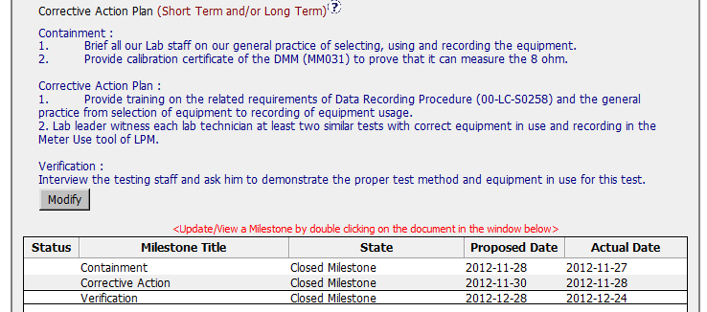
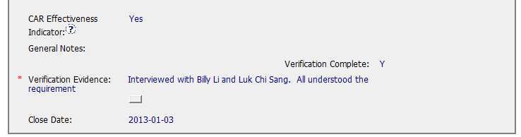
Exemplary Finding CAR No. 123911363
3
3. Containment ,corrective action and verification fix the objective evidence, address the entire root cause and address the items identified in the analysis, there is one suggestion, it is better to move verification to containment step 2 and move corrective action plan step 2 to verification.

Slide 5
Exemplary Finding CAR No. 123911363 Discussion
Clear analysis and describe with facts. And the root cause is reasonable and complete based on the analysis.
Scope tells us how widespread the problem is, for this CAR, it is just limited to this demonstration test.
Containment ,corrective action and verification fix the objective evidence, address the entire root cause and address the items identified in the analysis, there is one suggestion, it is better to move verification to containment step 2 and move corrective action plan step 2 to verification.

